Slide 2
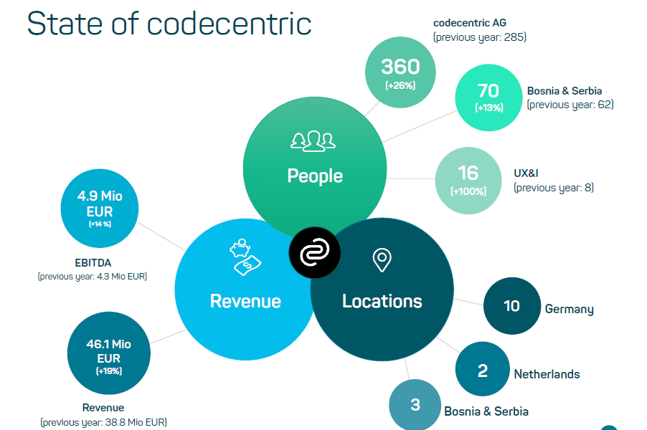
Ein paar Zahlen_

Slide 3
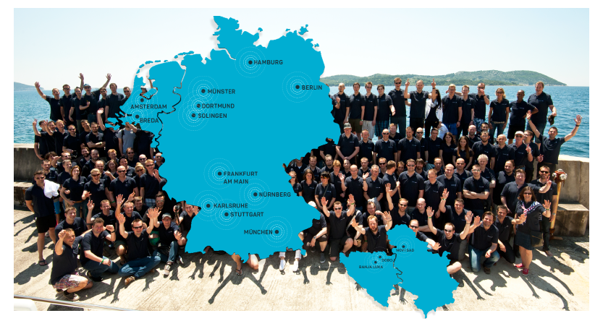
Unsere Standorte_

Slide 4

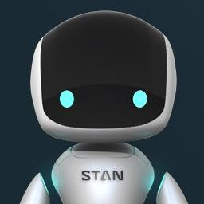


Unser Portfolio_
Strategische it-beratung
Cloud Technologien
Schulung
Agile Software Factory
Technology consulting

Slide 5

Unsere Erfolgsformel_
We love to solve real client problems with software in even better ways than before.
We are curious to learn new things!

Slide 6
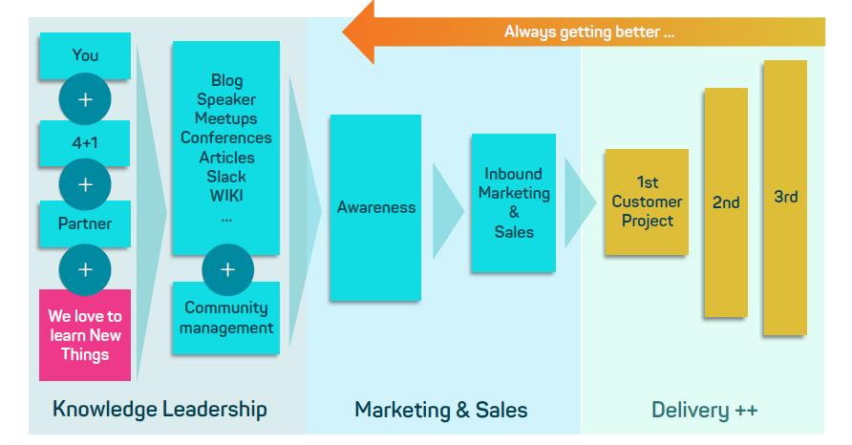
Unsere Erfolgsformel_

Slide 7
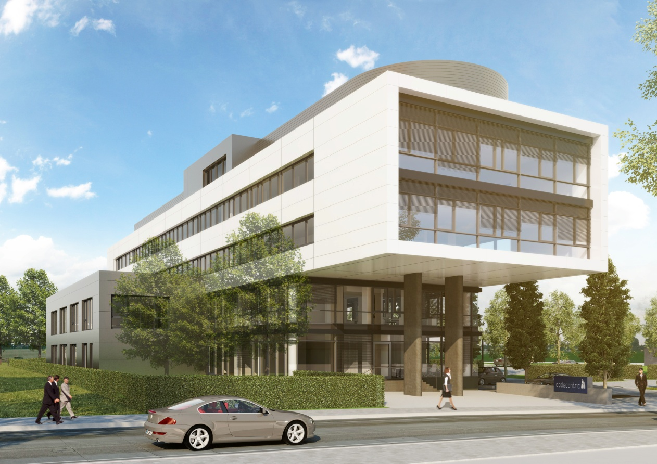
Unsere Firmenzentrale_

Slide 8
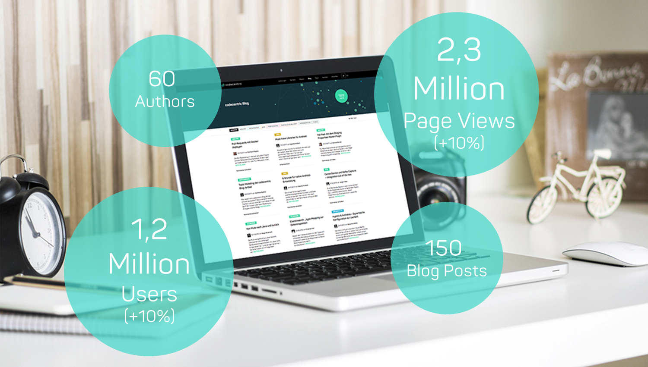
Awareness

Slide 9
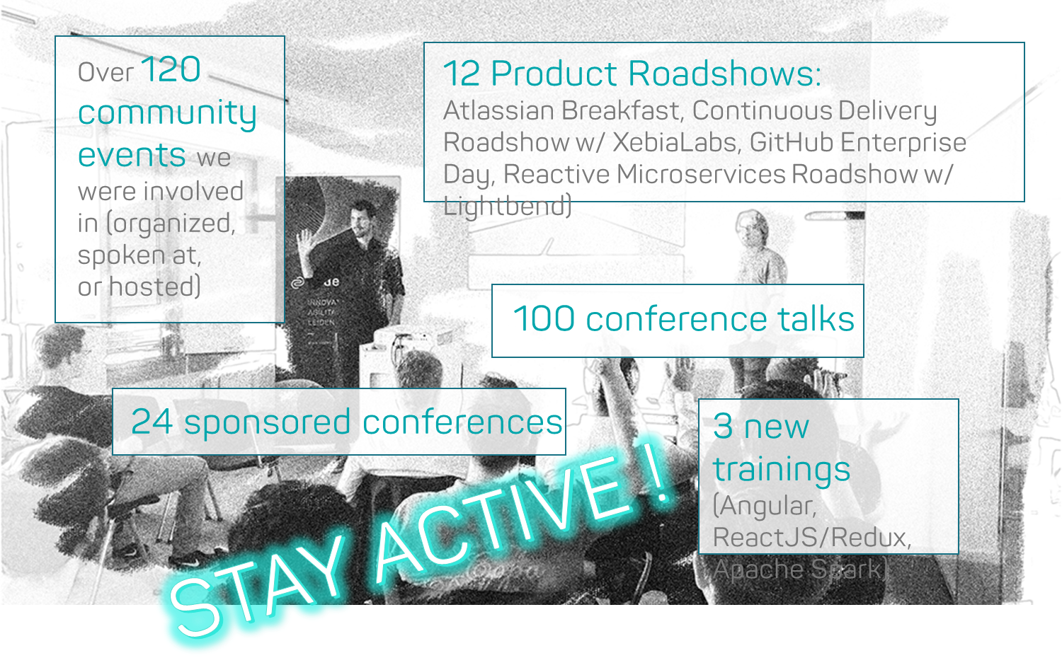
Knowledge Leadership

Slide 10
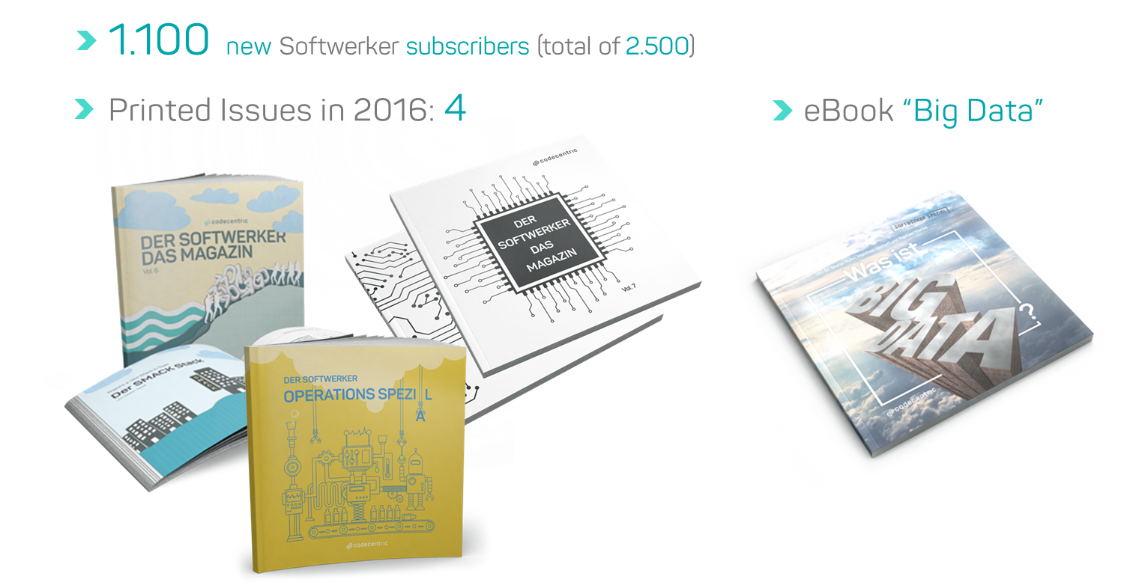
Knowledge Leadership_

Slide 11
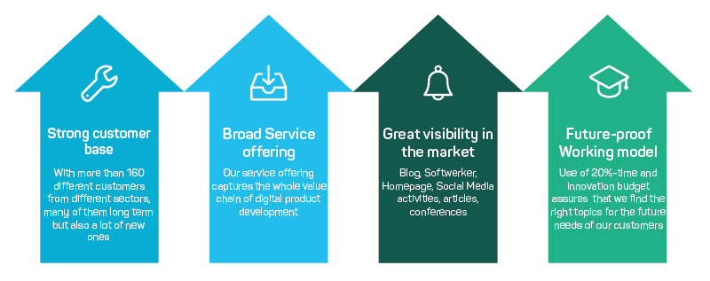
Gute Gründe

